Slide 1
Teamtreffen 01.08
Notes:
31.07.2023
1
1

Slide 2

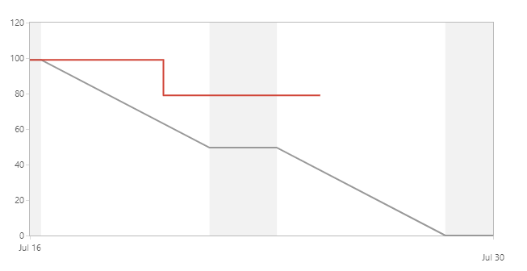
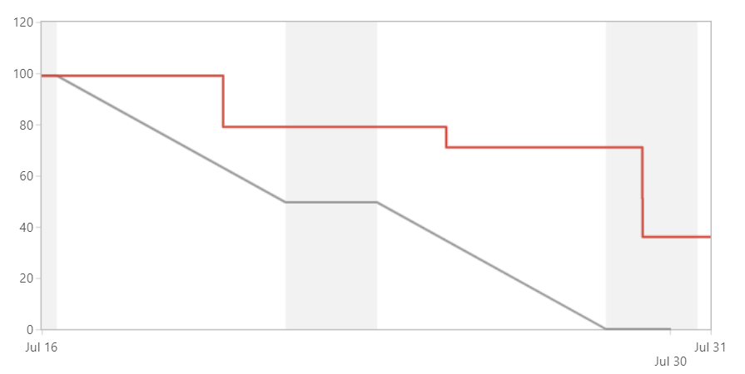
Burndown Sprint 1 v4
Sprint 1
Sprint 2

Slide 3
Sprint 1 v4 Entwicklung
Jonas:
Celina:
Sylvan:
Leon:
Luis:
Ali:
Armin:
Mondex
End Fight & Gain Coins
Join Fight & 2v2 & Bugfixes
Rooftiles & Mouse Movement & Tests
Shop & Inventar & End Fight
Statuseffekte & Refactoring
Doku
Notes:
31.07.2023
3
3

Slide 4
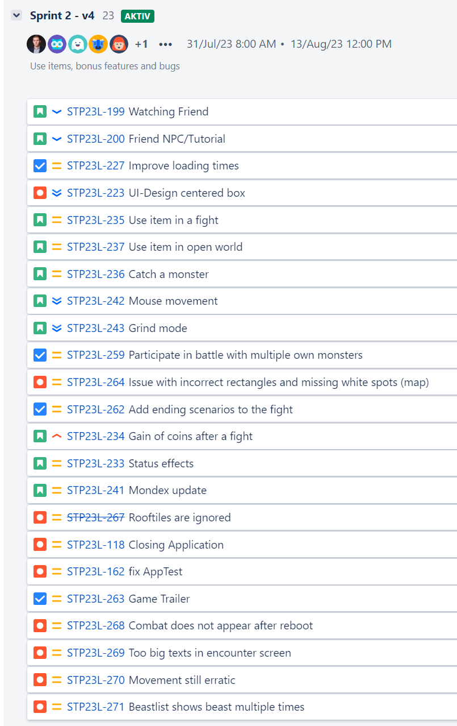
Sprint 2 v4 Ausblick

